Slide 1
eMASS Scope
Case Study Details

Slide 2
Outline:
Project case study
Task description
Data recording
Demo examples

Slide 3
Project case study:
In the process of zinc coating to steel strip inhomogeneous coating is done due to strip vibration. In inhomogeneous coating process hundred Tons of zinc wasted and also quality is reduced. To achieve the better quality and homogeneous coating of zinc to steel plate EMG introduced a system called electromagnetic strip stabilization system (e-MASS).
The electromagnetic strip stabilization system (eMASS) manufactured by EMG in Germany is a device for use in controlling the vibrations of steel strip in a non-contact manner through use of electromagnets and is in wide used all over the world.
It is installable on air knife units used to blow off any zinc attached to a steel strip in a zinc pot. The control device suppresses any vibration of the steel strip via the attraction of electromagnets and thus minimizes any quantity variations in the plated zinc.

Slide 4
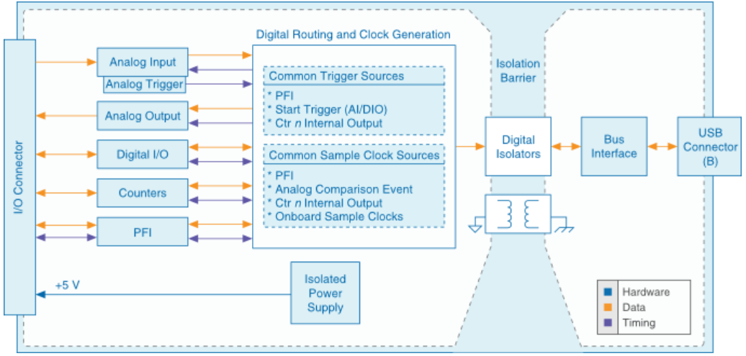
Task study:
Gone through the USB-6218 data acquisition device from National Instruments understands about USB Multi function I/O Device.

Slide 5
Task study:
The NI 9218 is a 2-channel, universal C Series module designed for universal measurements in NI Compact DAQ and Compact RIO systems.
The measurement type is selectable per channel, allowing you to perform different measurement types on each channel.
The NI 9218 is ideal for creating universal test systems for automotive, off-highway, and data-logging systems.
We have gone through PDF report generation toolkit also.
We also gone through database connectivity toolkit.

Slide 6
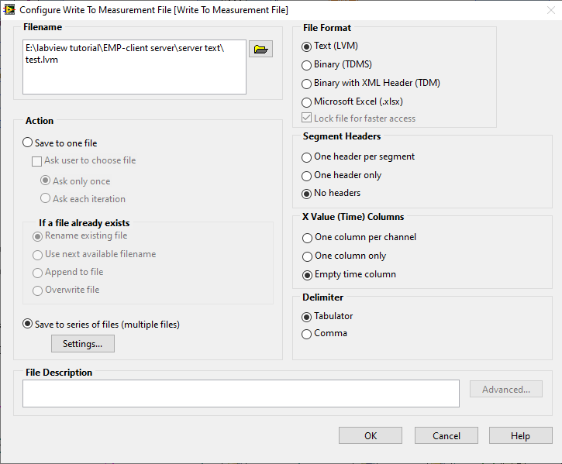
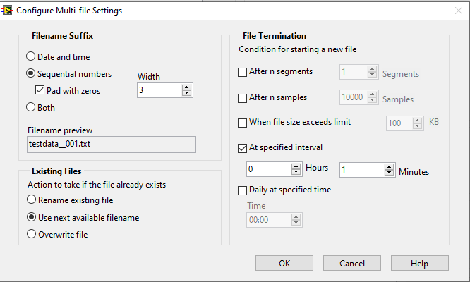
Data Recording:
Primary concern for the data recording is data measurement and data security, measured data must be lossless and stored in to the files.
As shown in the above figures, data recording configuration can be set based on file size or time interval.
By using the above features can achieve the hard disk capacity of 500GB and can store the data approx 700 days.

Slide 7
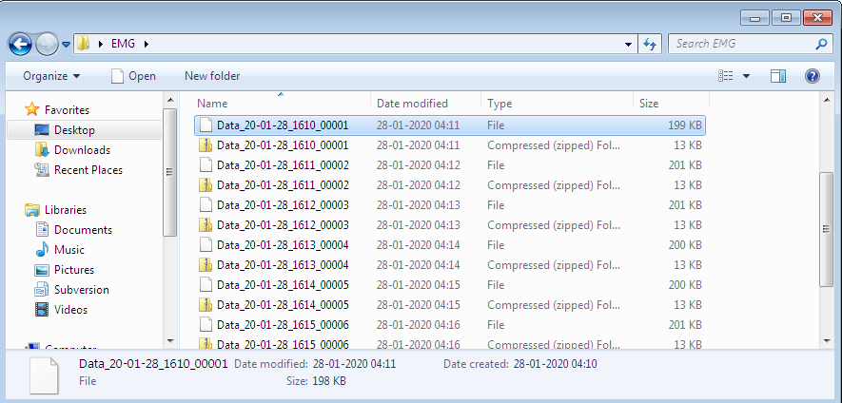
Data recording and zipping files:
In the above image we shown data recording is performing into the current file and Zipping operation on every 1 min interval.

